Slide 1












EC2 Spot Instance Interruption Notices
AWS Cloud
CloudWatch Logs Agent pushes your logs to AWS
Propagate and trigger additional logic
Spot Fleet
EC2 instance contents
Amazon CloudWatch
2. Notify
AWS Lambda
Amazon DynamoDB
AWS Lambda
watchdog
1. Read the metadata every 5 secs
your app
Instance Metadata:
http://169.254.169.254/latest/meta-data/spot/termination-time
event
rule
Amazon Simple Notification Service
404 | 2015-01-05T18:02:00Z
Amazon Simple Queue Service
two-minute warning before Amazon EC2 must stop or terminate your Spot Instance

Slide 2
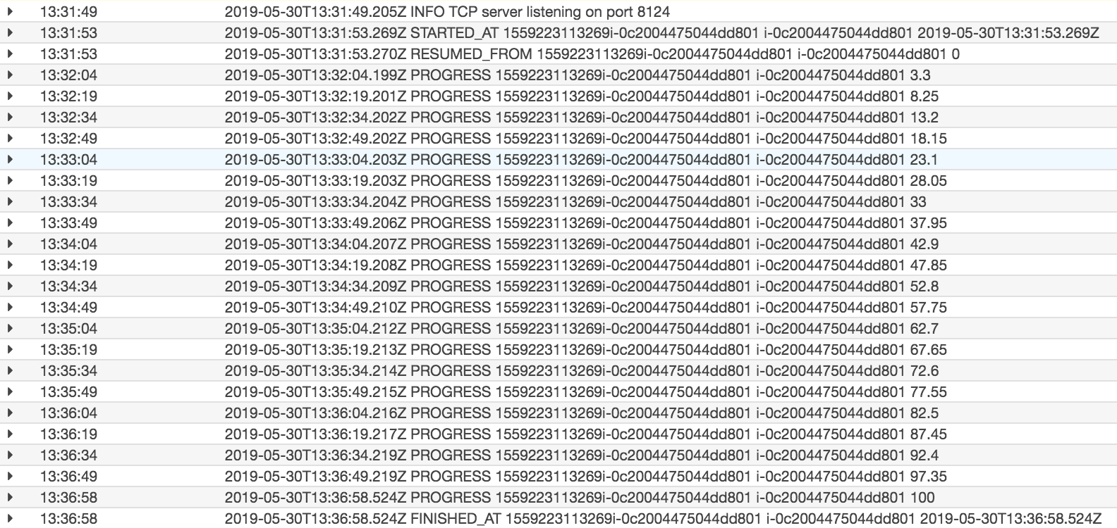
App Logs – No Interruptions
1
2
3
4

Slide 3
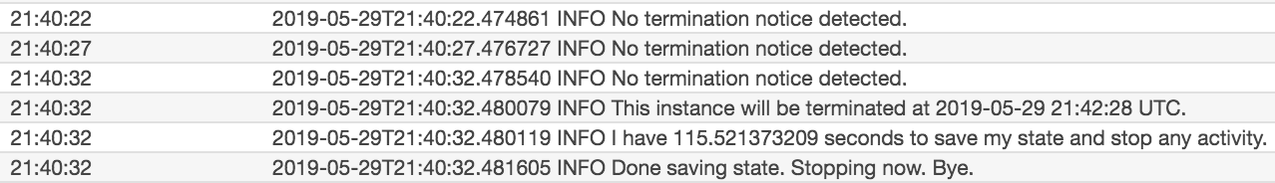
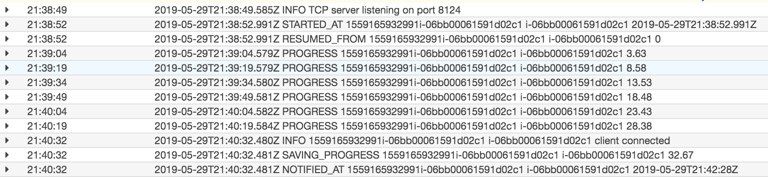
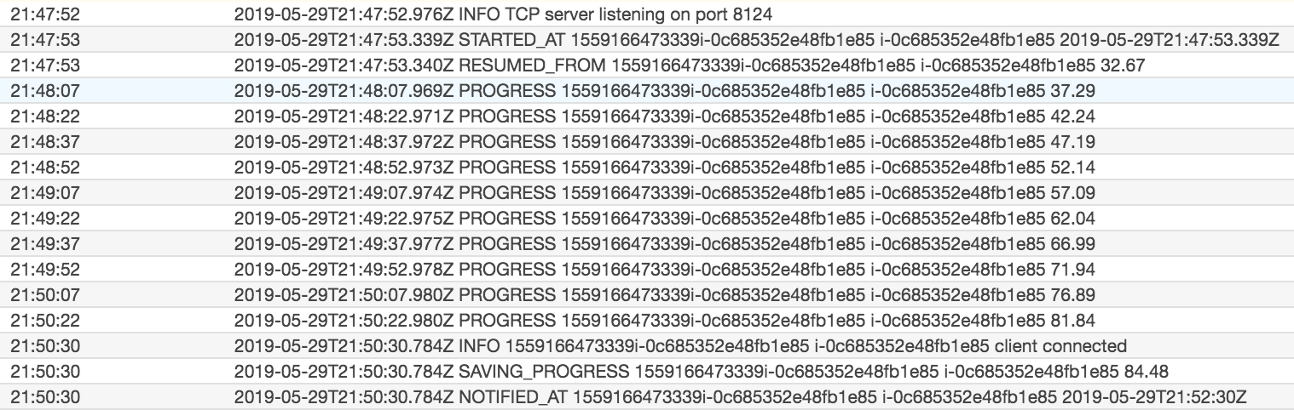
App Logs Events – Interruptions
Watchdog checks for
interruptions every 5 seconds.
Termination notification
Time to save state and stop
TCP Listener
watchdog notifies app
Saves state and notification time
Resumes from previous progress

Slide 4
Demo

Slide 5
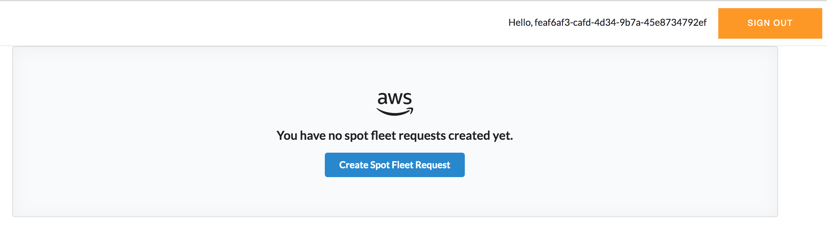

Slide 6
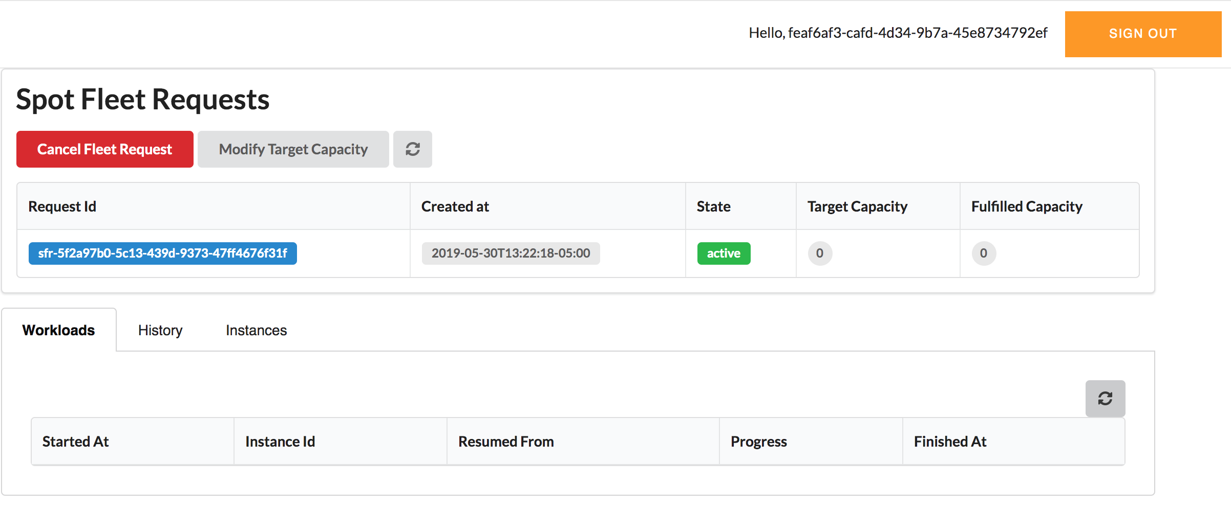

Slide 7
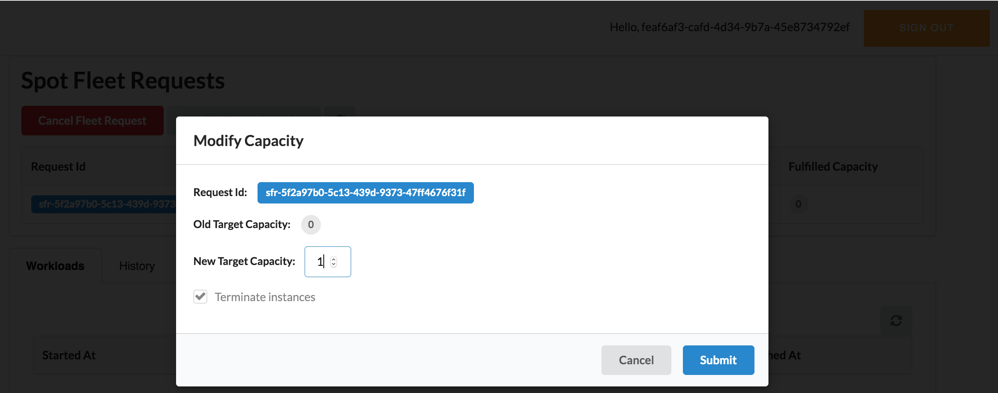

Slide 8
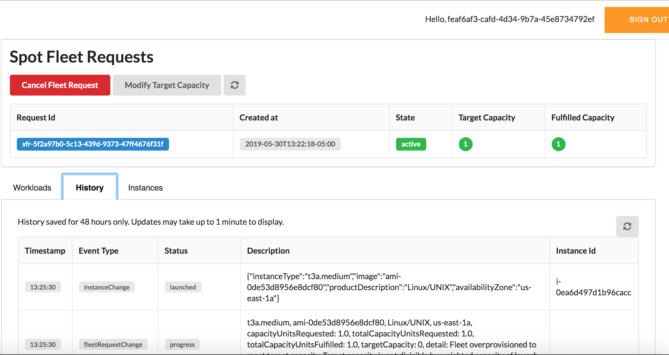

Slide 9
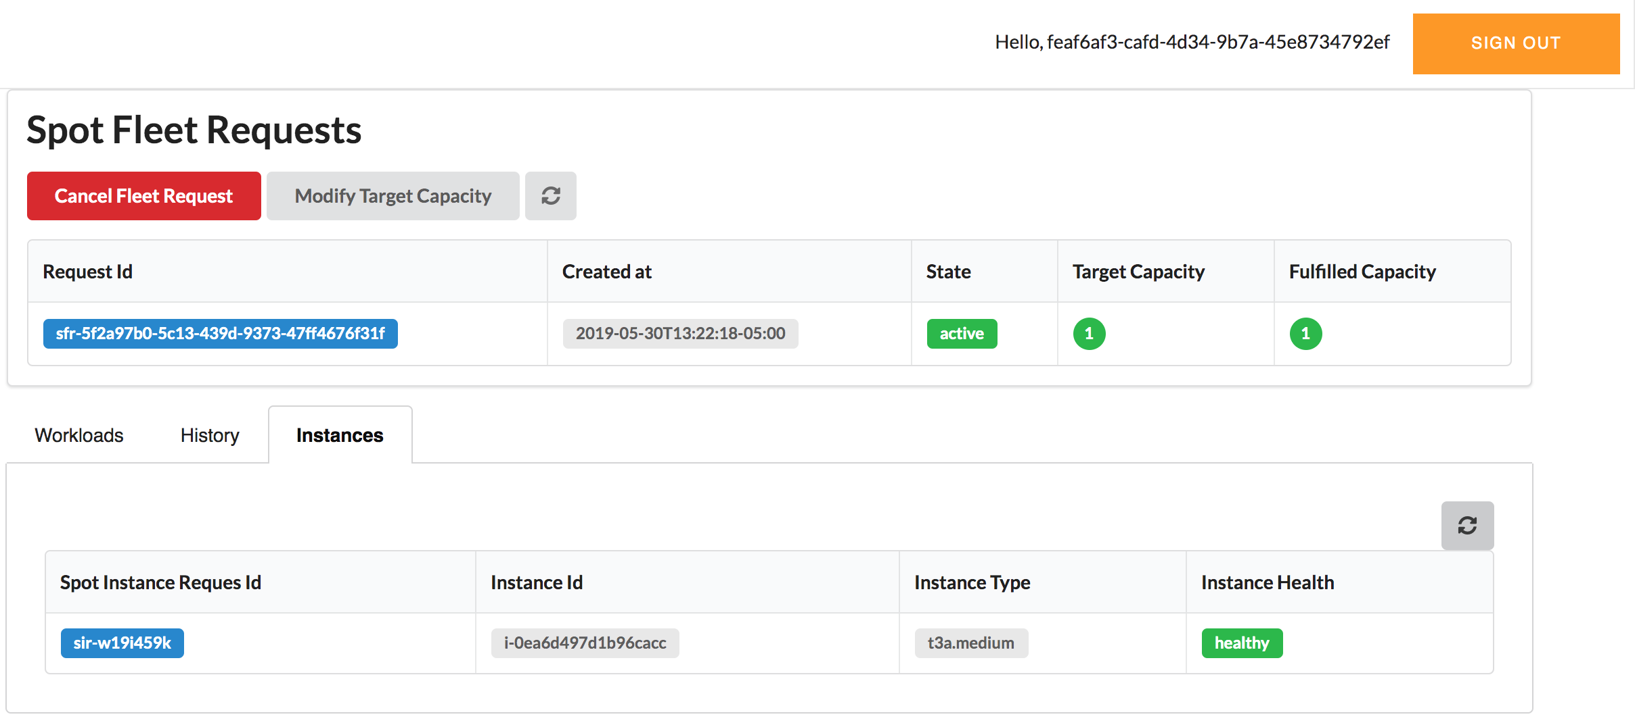

Slide 10
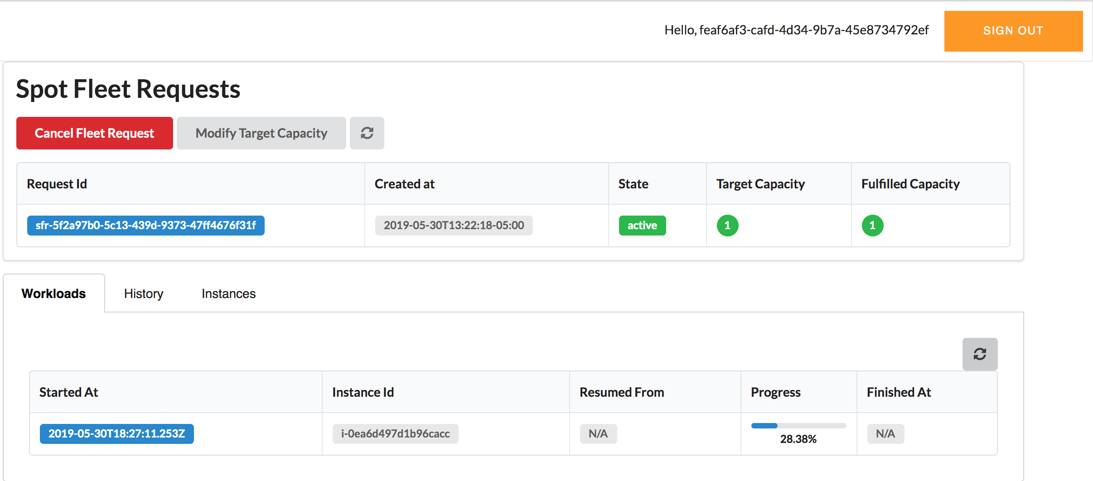

Slide 11
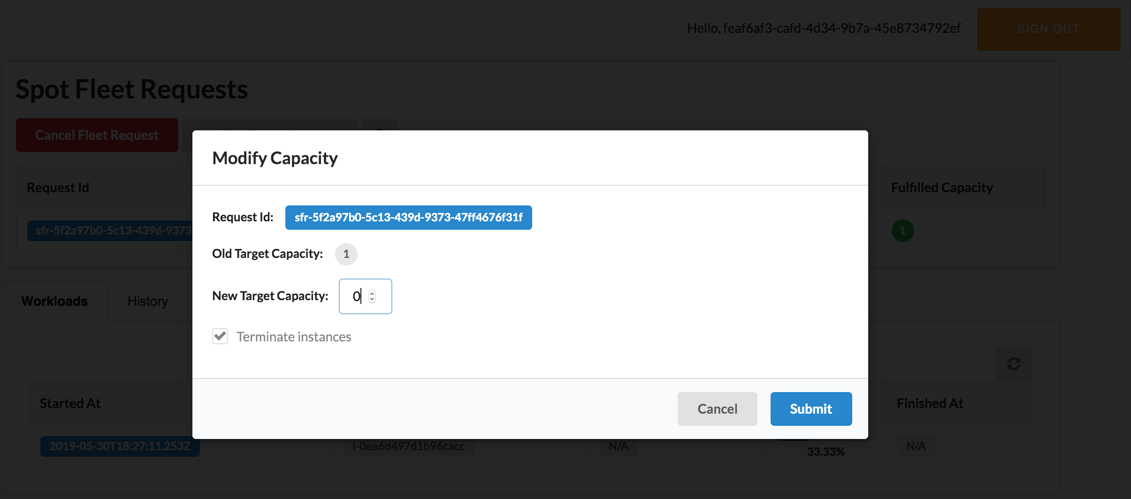

Slide 12
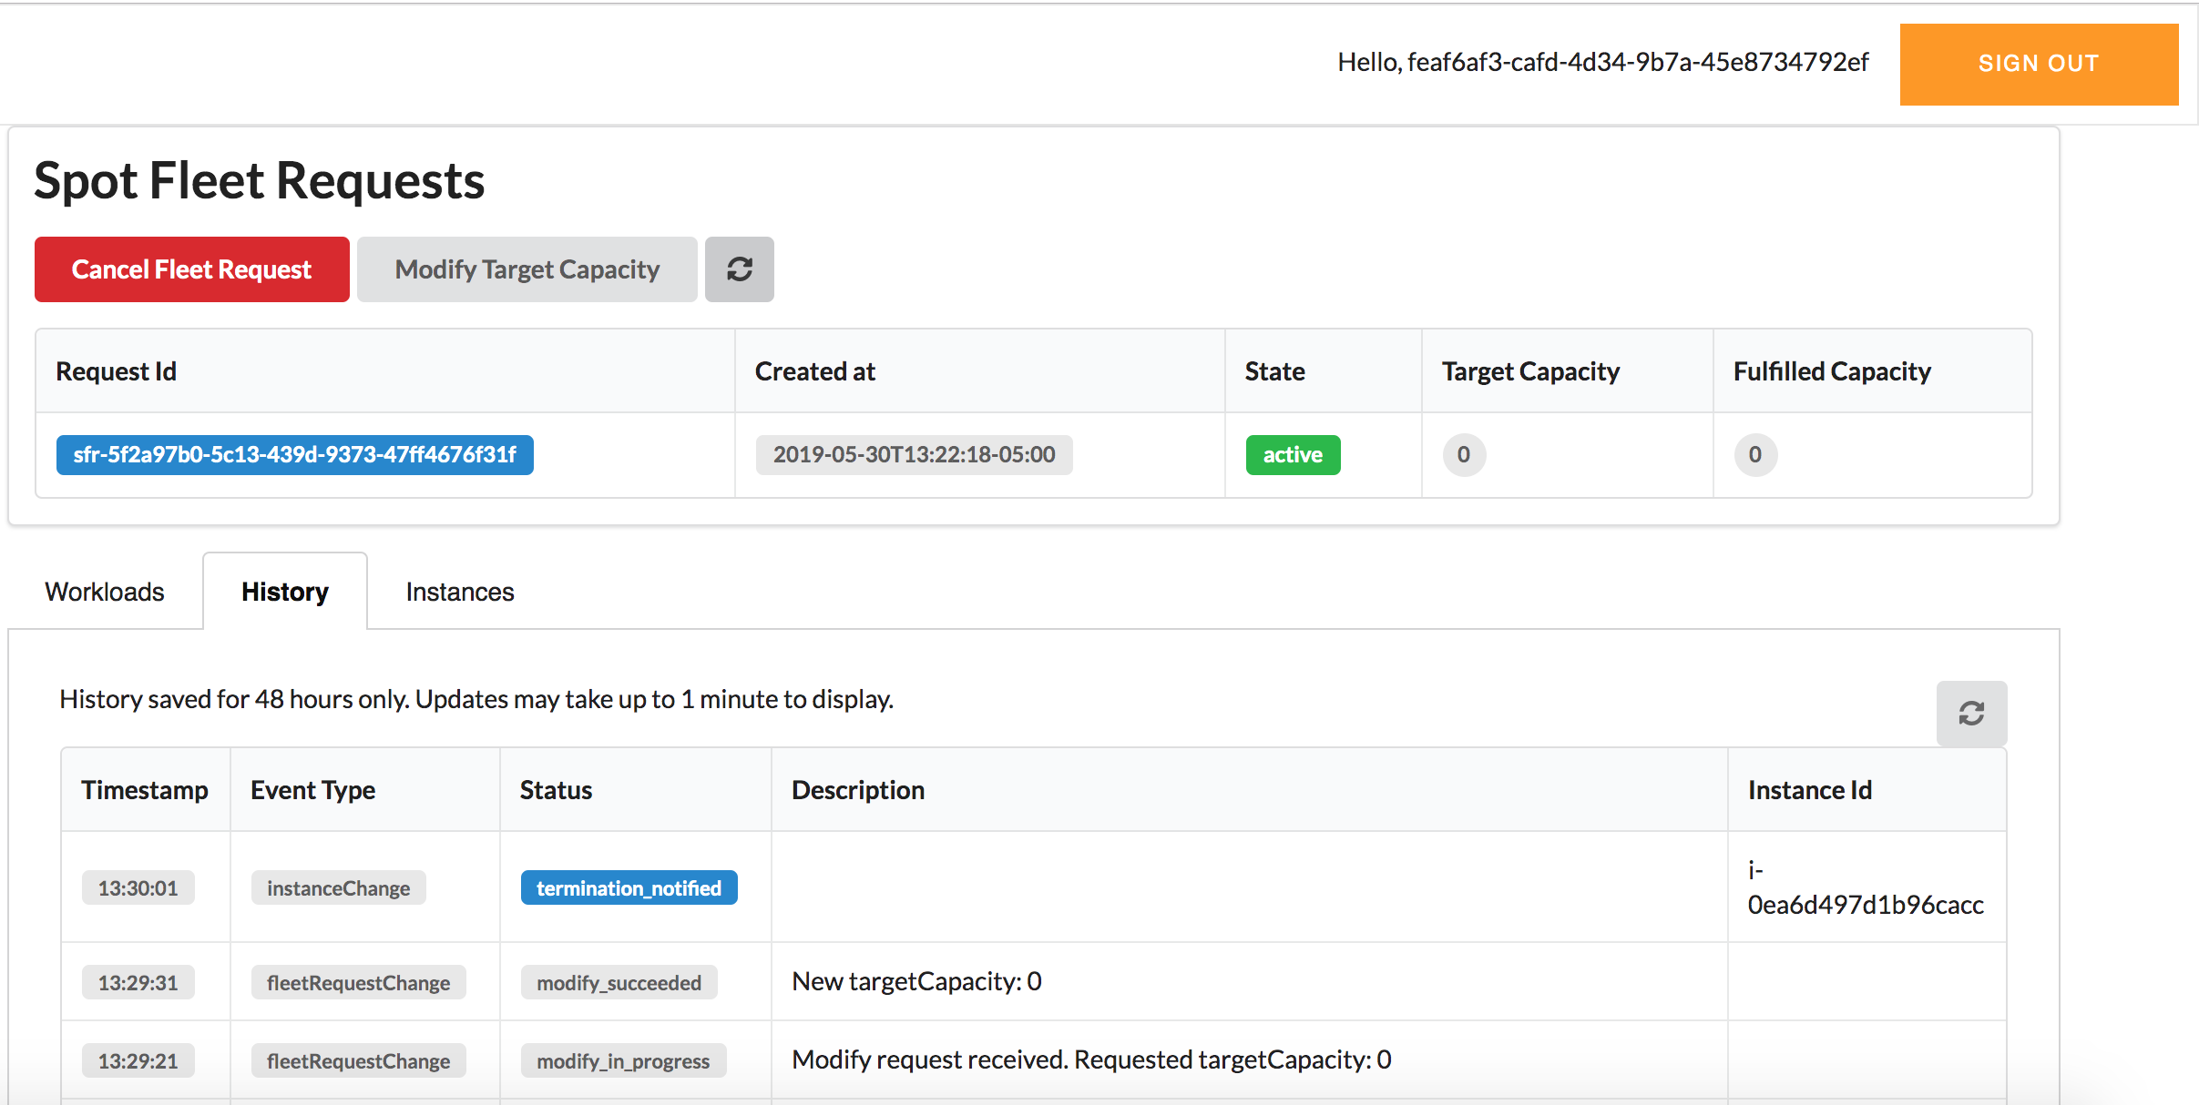

Slide 13
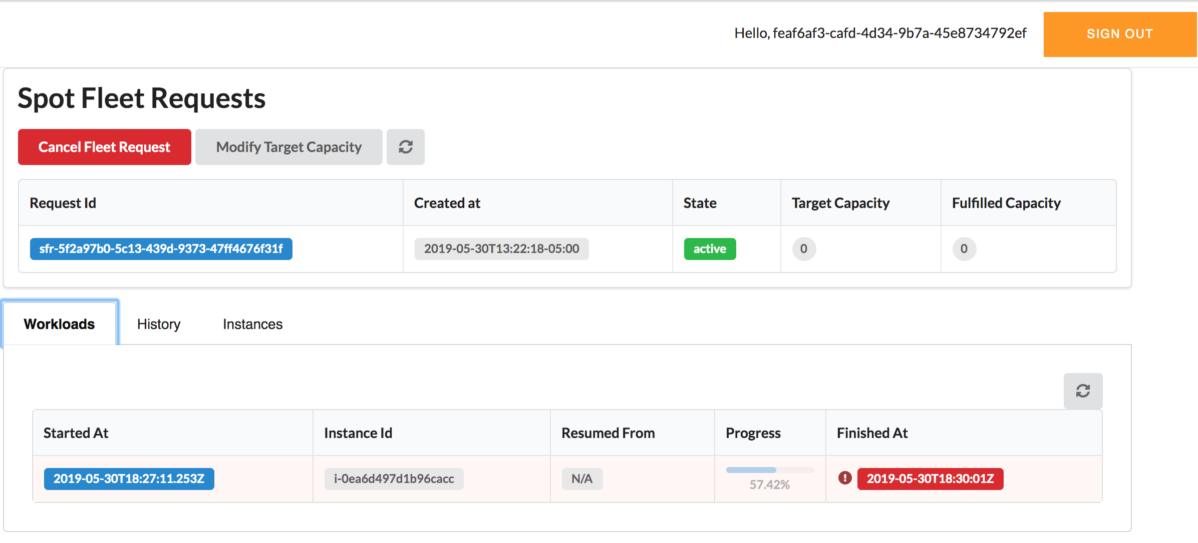

Slide 15
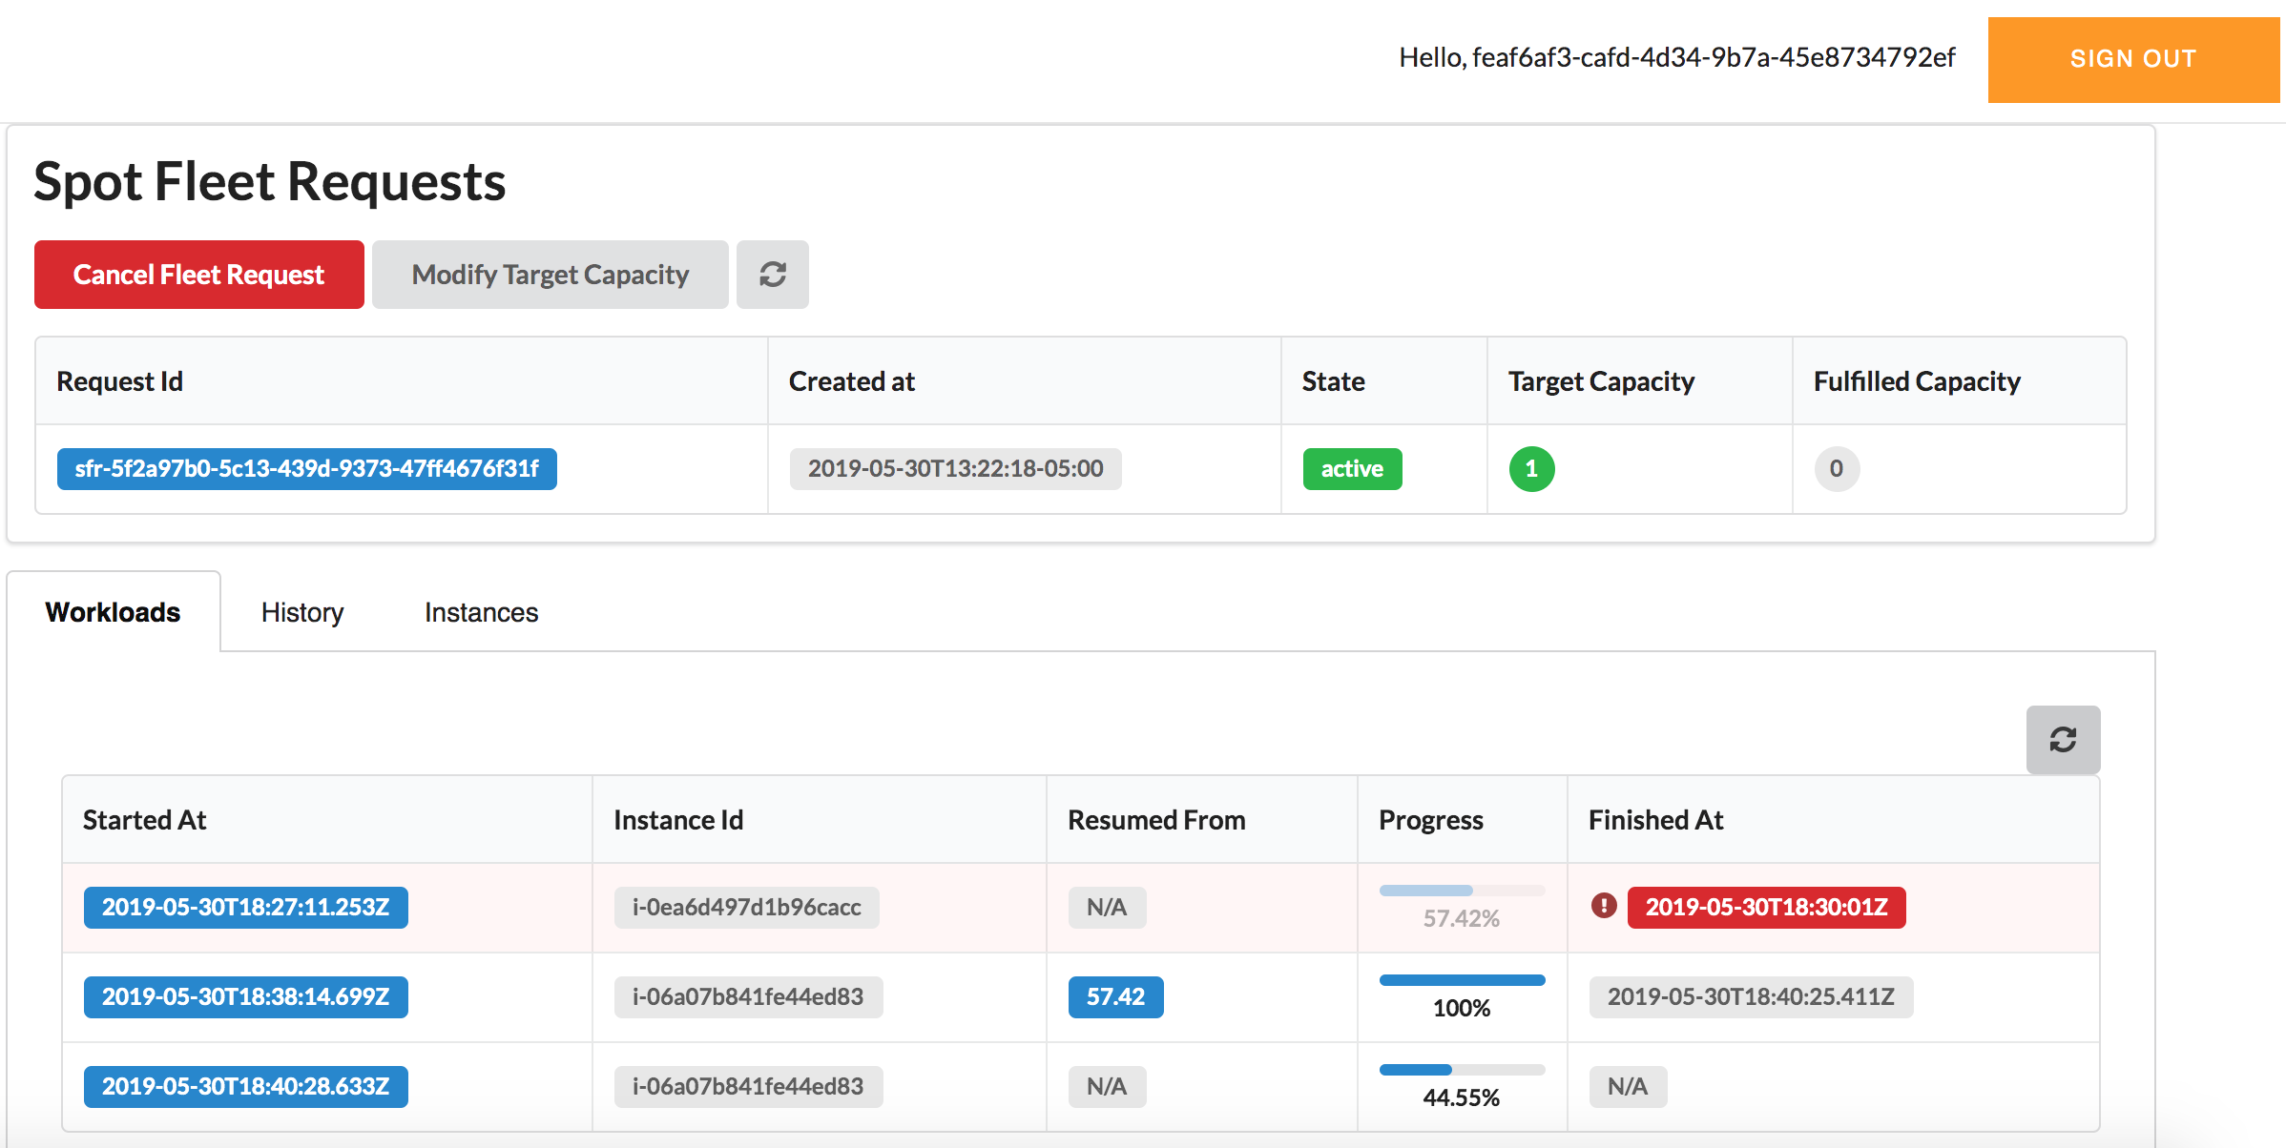

Slide 16
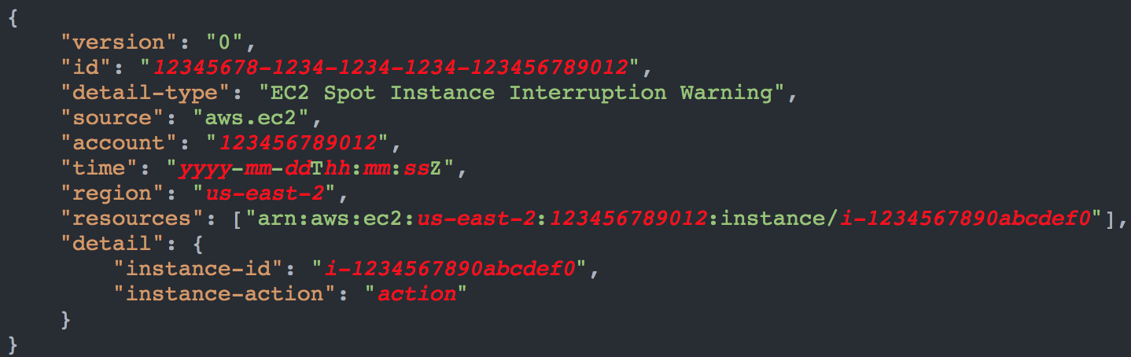
EC2 Spot Instance Interruption Event
hibernate, stop or terminate
https://docs.aws.amazon.com/AWSEC2/latest/UserGuide/spot-interruptions.html

Slide 17
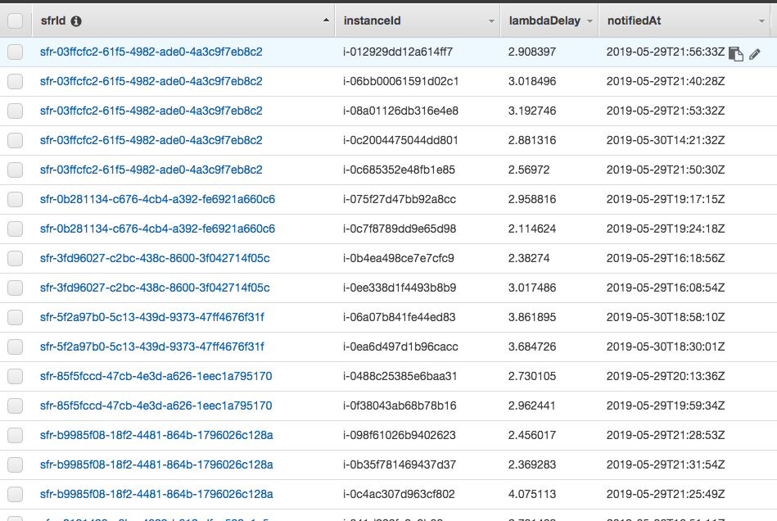
CloudWatch Events Notifications

